Slide 1
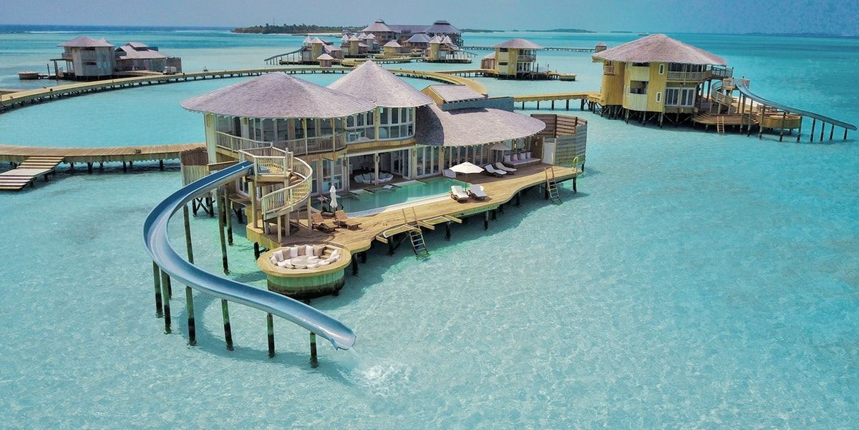
Odyssey
Are you ready to explore the world? Join us on a journey of discovery with Odyssey's travelling website. Our team of experts has curated a selection of unique destinations for the adventurous traveler. Get inspired and book your next adventure today!

Slide 2

Index
Introduction
Our Vision
System Required
Software Requirements
Advantages & Disadvantages
Future Aims / Goals
Gallery
Conclusion

Slide 3
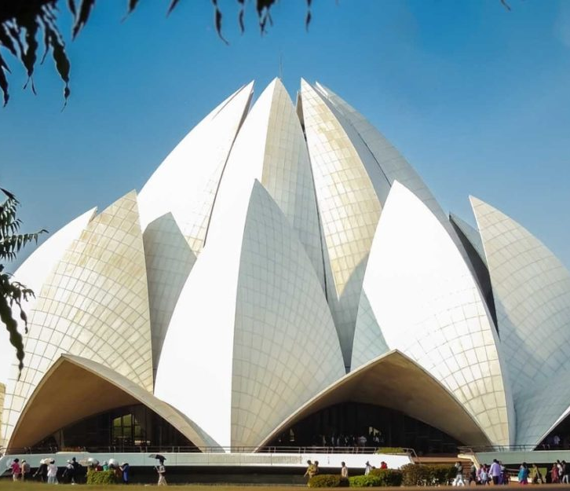


Introduction
Experience the local culture and connect with people from around the world. Our website offers unique travel experiences that allow you to immerse yourself in the local community.
Meet new friends and create unforgettable memories. Get out of your comfort zone and unleash your inner explorer.
Our website offers a range of adventure activities, from hiking and biking to scuba diving and surfing. Try something new and challenge yourself!

Slide 4

Our Vision
Our goal is to give our consumers a smooth travel experience from planning to booking and beyond.
Everybody should be able to travel, and we aim to assist our clients in making lifelong memories.

Slide 5
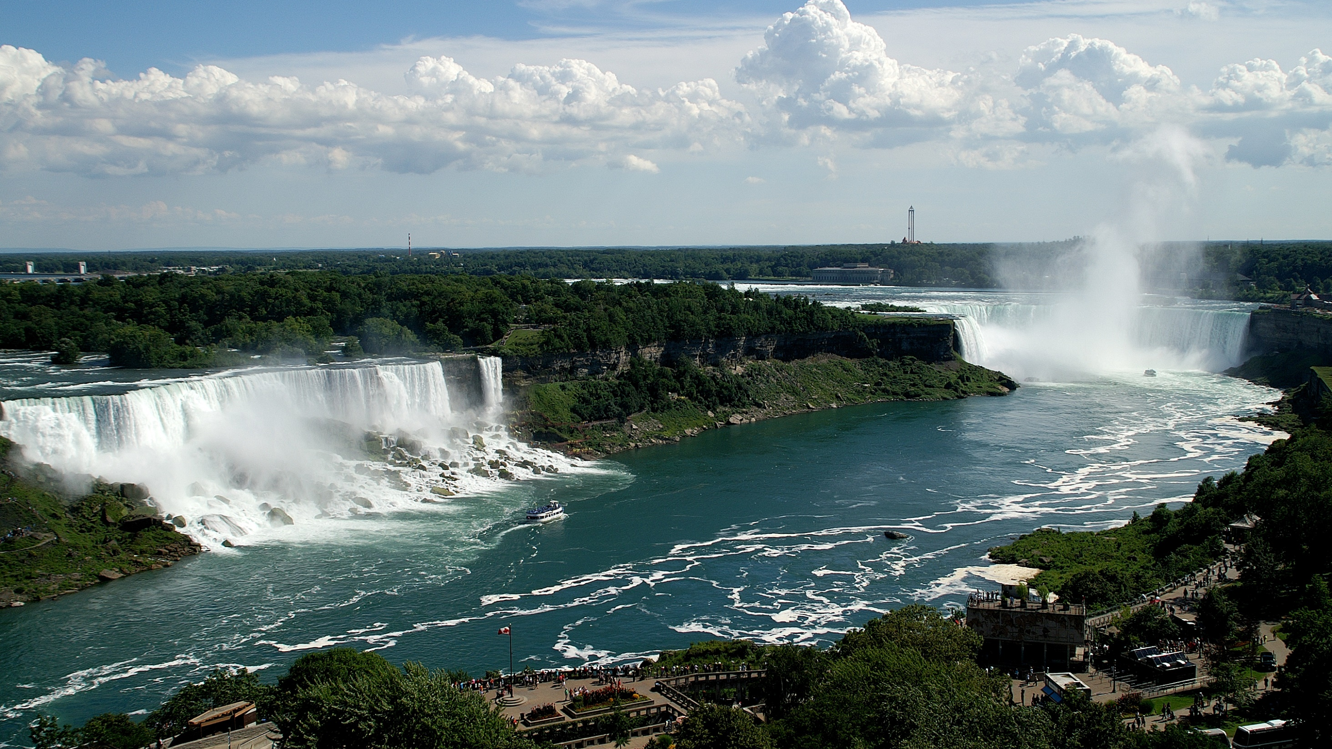
System Requirements
Any device with an internet connection can access Odyssey, which is a web-based platform.
All screen sizes, including those of PCs, laptops, tablets, and smartphones, are supported by our website.
For the greatest user experience, we advise utilising the most recent versions of Microsoft Edge, Mozilla Firefox, Safari, and Google Chrome.

Slide 6
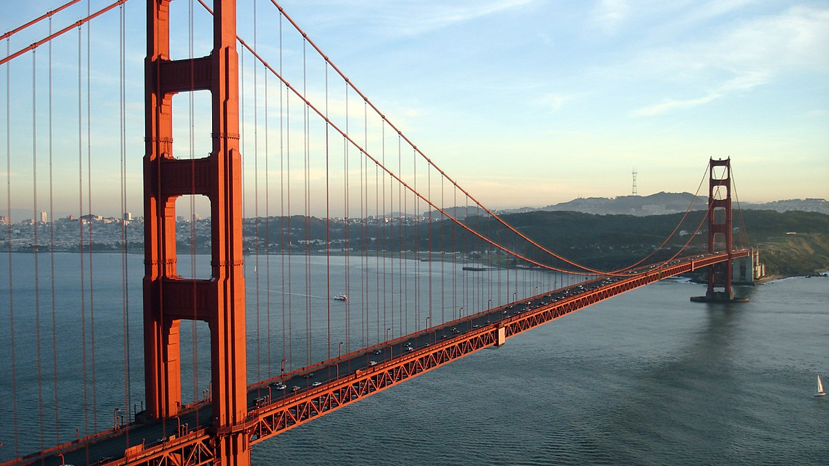
Software Requirements
HTML
CSS
JavaScript

Slide 7
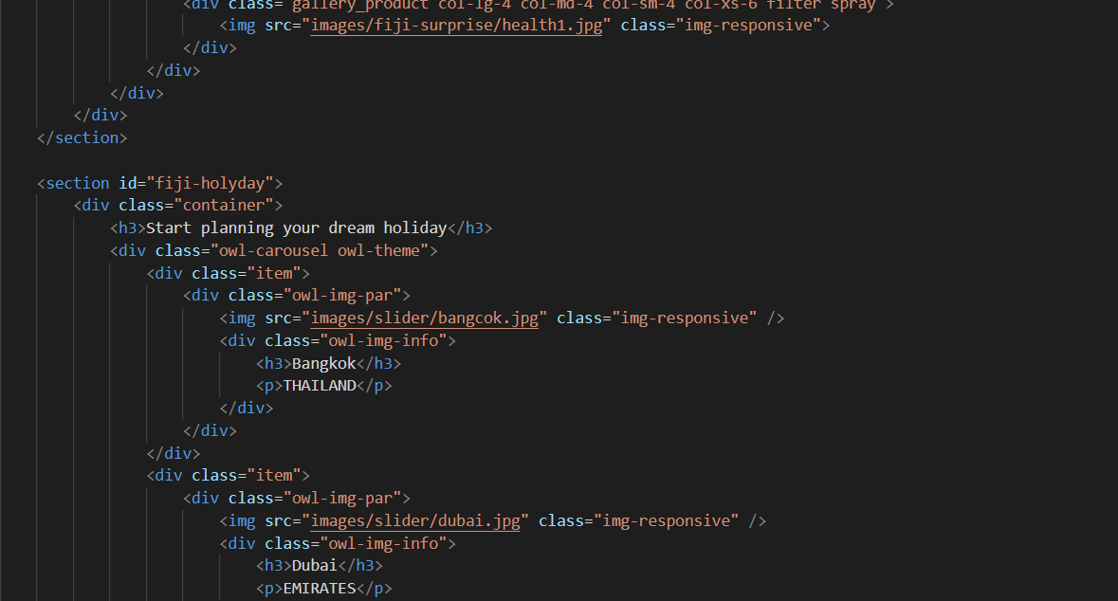
The Hyper Text Markup Language or HTML is the standard markup language for documents designed to be displayed in a web browser.
HTML
The HTML element is used by front-end developers to identify the type of information that each item on a webpage contains; for example, the HTML element "p" denotes a paragraph.

Slide 8
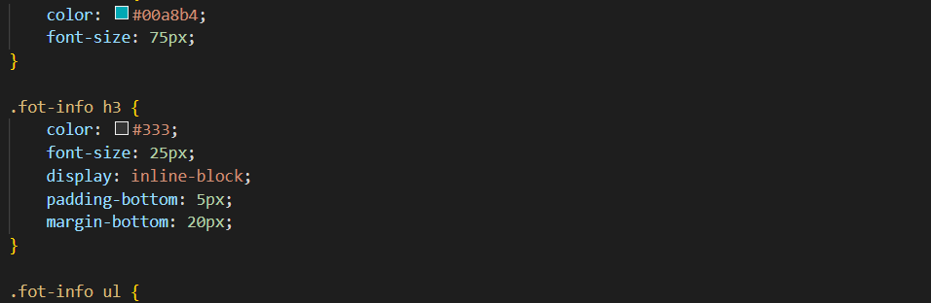
Cascading Style Sheets (CSS) is a style sheet language used for describing the presentation of a document written in a markup language such as HTML or XML.
CSS
Web pages are styled and laid up using CSS (Cascading Style Sheets), which may be used to change the font, color, size, and spacing of your information, divide it into numerous columns, or add animations and other ornamental elements.

Slide 9
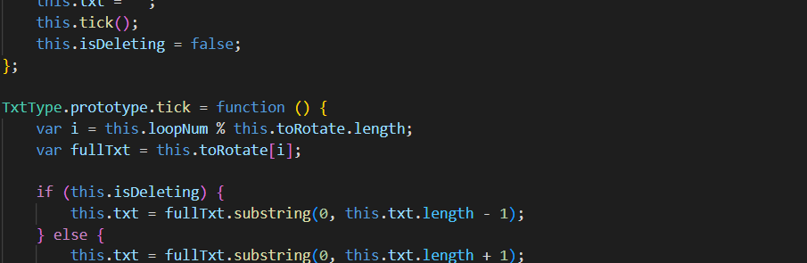
JavaScript is a scripting language used to develop web pages. Developed in Netscape, JS allows developers to create a dynamic and interactive web page to interact with visitors and execute complex actions.
JavaScript
Web pages are created using the scripting language JavaScript. JS enables programmers to create dynamic and interactive web pages that interact with users and carry out complicated actions.

Slide 10

Advantages
Disadvantages
Comprehensive Travel Resources
Limited coverage in certain areas and locations.
User-friendly Interface
Limited Customisation
Secure Payment System
Reliance on Technology
Customer Service

Slide 11

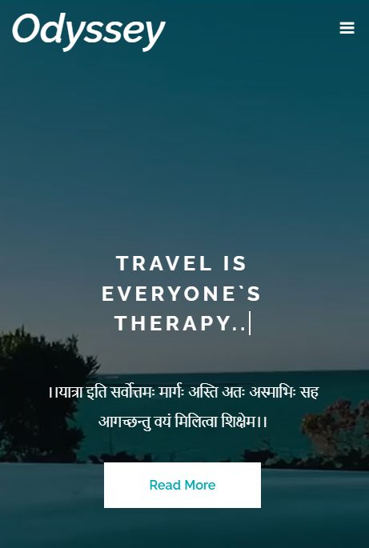




Future Aims
We're working on new features and tools to make booking and organising trips even simpler and more convenient, as well as expanding our travel resources to cover more locations and activities.
In Future, We would also provide access to different devices like Mobiles, Tablets, etc.
Can also be adding new features like Social Media platform to share the experience, connecting databases to ensure the confirmed trips, etc.

Slide 12
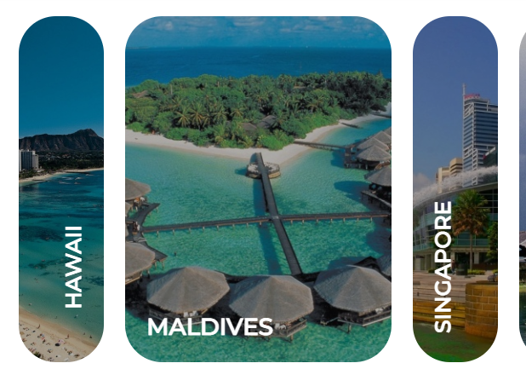
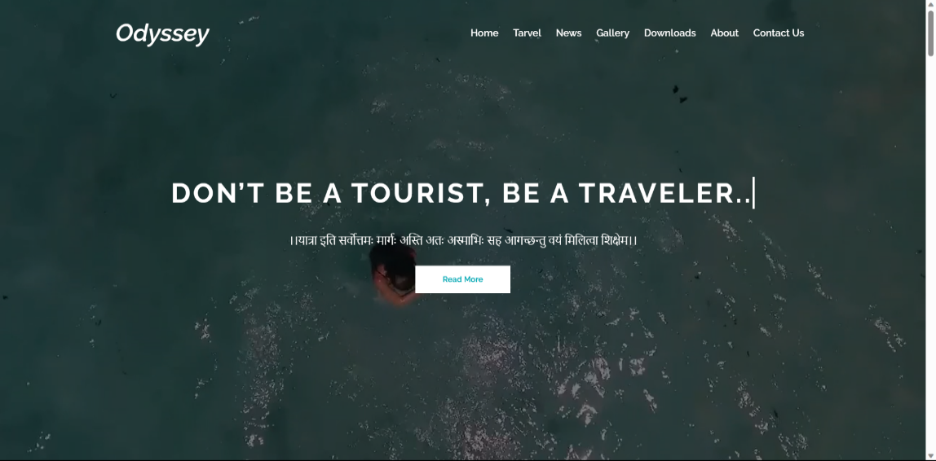
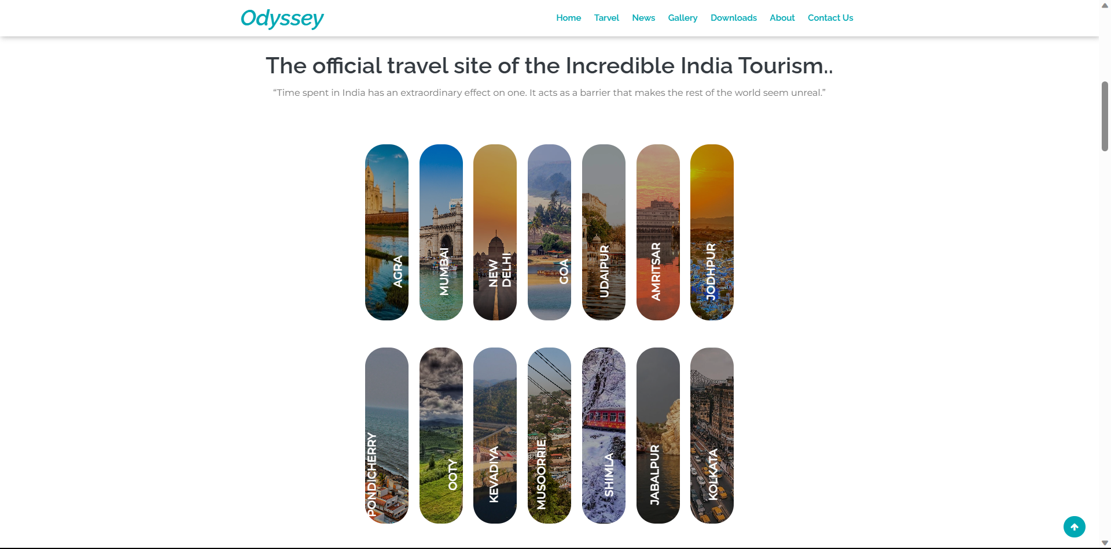
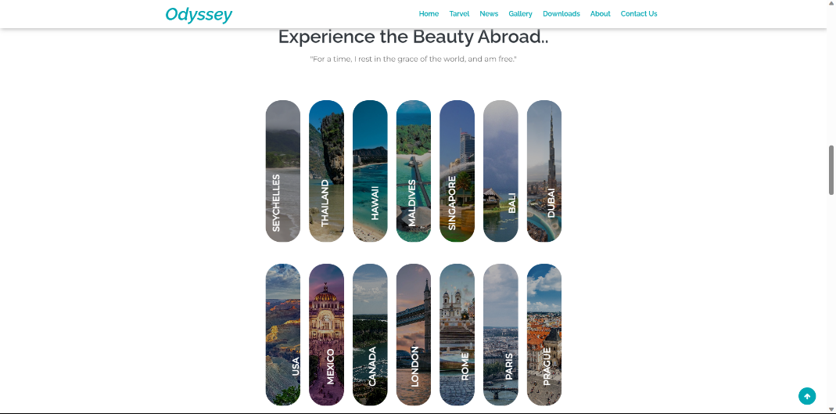
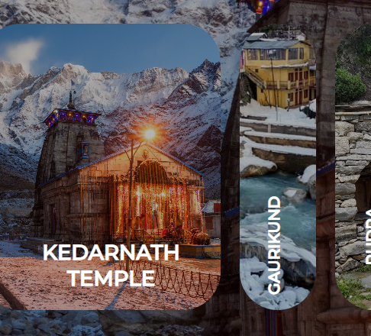
Home Page
GALLERY
Travel Page
Other Webpages

Slide 13

Conclusion
In summary, Odyssey provides a complete travel solution for all of your travel requirements.
We want to make vacation planning simple, convenient, and pleasant with our user-friendly website, affordable prices, and tailored advice.
Come along with us as we go into a world beyond what is imaginable.

Slide 14



Our Team
Vraj Patel
Harsh Mistry
Aayush Modi
2101201193
2101201055
2101201004
Website Development with JavaScript
Development of Website with Designing
Designing of Website and Web Development

Slide 15
Thank You
।।यात्रा इति सर्वोत्तमः मार्गः अस्ति अतः अस्माभिः सह आगच्छन्तु वयं मिलित्वा शिक्षेम।।

